Slide 1



Checkpoint Cymru
Y Flwyddyn Gyntaf
The First Year
Anna Baker

Slide 2
Lleihau aildroseddu a gwella cyfleoedd bywyd
Reducing reoffending and improving life chances
Sut yr ydym wedi mynd ati i wneud hyn?
How have we gone about undertaking this?

Slide 3

Covid-19
Sut ‘wnaethom addasu
How we adapted
Gweithio o adref / Working from home
Asesiadau dros ffon / Assessments over the phone
Ymyriadau dros ffon / Interventions over the phone
Dychwelyd yn raddol ir gymuned / Phased return to the community

Slide 4
Er y feirws oedd raid dal ati
Despite the virus we had to continue…

Slide 5
Newidiadau trwy y Cyfnod Clo
Changes through lockdown

Slide 6
Rhaglen Addysg Cyffuriau
Drug Education Programme
Newid mewn tueddiadau / Change in trends
Pawb yn cysgodi ond yr sawl yn gaeth I gyffuriau dal ar y strydoedd / Most were shielding, but those with addiction were more obvious on the street
Niferoedd yn Cynyddu ac yn cael eu cyfeirio i’r rhaglen am sesiyna 1-1 / Number of referrals increased for 1-1 sessions
Dynion yn agor I fyny fwy dros y ffon/ Men would open up more over the phone
Merched yn ffafrio cwrdd / Females prefer meeting

Slide 7
Wrth asesu anghenion y person ac eu cyfeirio ymlaen, lle mae’n briodol a cydweithio efo amrhyw o asiantaethau
By assessing each person’s needs and making relevant referrals where needed and working collaboratively with various agencies

Slide 8
Anghenion canfyddadwy
Identified Needs
Iechyd Meddwl / Mental Health
Iechyd Corfforol / Physical Health
Defnydd Cyffuriau / Drug Use
Defnydd alcohol / Alcohol use
Addysg, hyfforddiant a Chyflogaeth Education, Training and employment
Trais yn y cartref / Domestic Violence
Llety / Accommodation
PNaP / ACEs

Slide 9
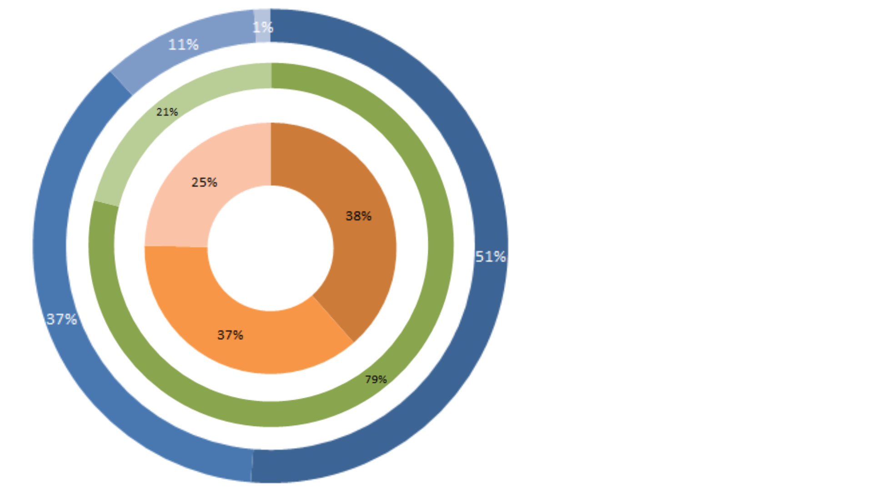
Total referrals - 527
Eastern referrals
Central referrals
Western referrals
Referral Gender
Male referrals
Female referrals
Referral age range
18-24
25-40
41-65
65+

Slide 10
Niferoedd Checkpoint ag RAC
Checkpoint Numbers and DEP

Slide 11
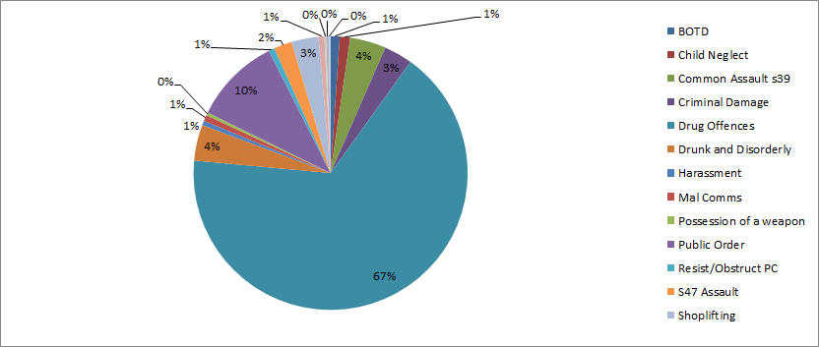
Types of offences

Slide 12
Asiantaethau
Agencies
Kaleidoscope
Cais
Wallich
Gorwel
DASU
NWWC – Pathfinder
BIPBC / BCUBH
Hafal
AGaP/DWP

Slide 13
Astudiaethau Achos
Case Studies

Slide 14
‘Really helpful and for the first time in years a feeling that I was not walking alone with my mental health issues and the problems that caused them’

Slide 15
“Defnyddiol iawn, ag am y tro cynta’ mewn blynyddoedd roeddwn yn teimlo fy mod ddim ar ben fy hyn efo fy mhroblemau iechyd meddwl a’r rhesyma’ a wnaeth achosi nhw”

Slide 16

Deuddeg Mis Nesaf
Next 12 months

Slide 17
Meddwl Ymlaen
Thinking Ahead
Be wnaethom golli yn 2020 / What we missed in 2020
Edrych ar y bylchau mewn cefnogaeth e.e Gamblo / Looking at the gaps in support e.g Gambling
Mwy o Gyfiawnder Adferol / More Restorative Justice
Cyfathrebiadau / Communications
Adeiladau ar y sylfaen da / Build on the good foundation
Ehangu y rhaglen efo achosion mwy cymleth / Expand the programme with more complex cases
Casgliadau o adroddiad Prifysgol Bangor / Findings from the Bangor University report

Slide 18
Diolch
Thank you

